Slide 1
BIT 245
RDBMS With SQL
Sushil Bhattarai
sushil.bhattarai@texascollege.edu.np
Lincoln University College, CN 1221

Slide 2
Data models

Slide 3
Entity Relationship Model
An ERD shows the relationships of entity sets stored in a database, graphically.
Entity in a database could be a single person, place, or thing about which data can be stored.
Each entity has a set of properties. The properties of each entity are termed as attributes. Eg. Student can be an entity and would be described by attributes such as RollNumber, Semester, Address etc.
Relationships are meaningful associations between or among entities.
Relationships are represented as lines connecting the points and shapes.
 | A rectangle represents an Entity. |  | One To One
 | An oval represents an Attribute. |  | One To Many
 | A diamond represents Relationship. |  | Many To Many
Entity Relationship Model
3

Slide 4
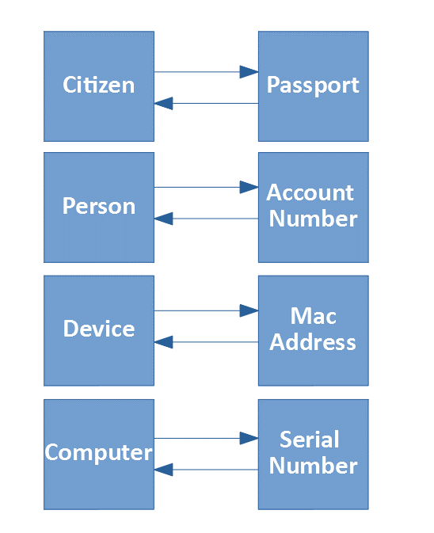
Types of Relations
One-to-One

Slide 5
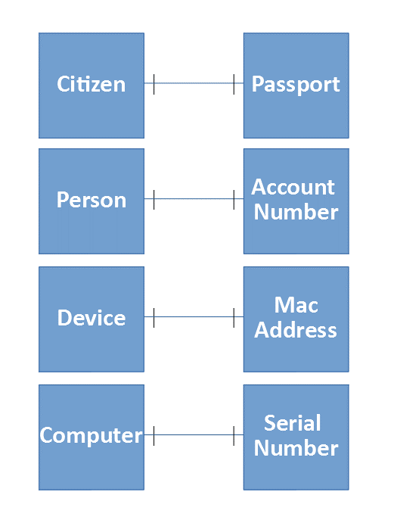
Types of Relations
One-to-One
Single record in the first table is related to only one record in the second table, and a single record in the second table is related to only one record in the first table
The above relations can be represented as

Slide 6
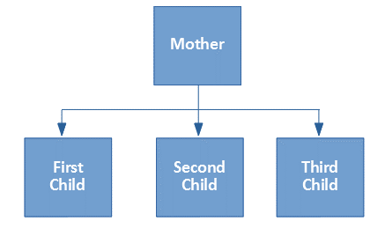
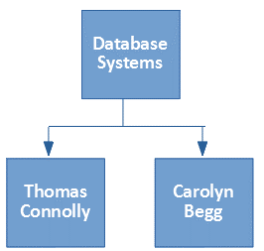
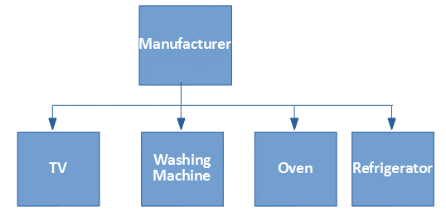
Types of Relations
One-to-Many
One mother has many children
(many children have one mother)
One book written by many authors (many authors write
one book)
One Manufacturer produce many products
(many products produced by one manufacturer)

Slide 7
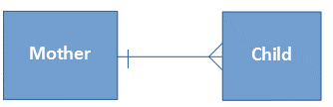


Types of Relations
One-to-Many
Single record in the first table can be related to one or more records in the second table, and multiple records in the second table can be related to only one record in the first table.
The above relations can be represented as

Slide 8

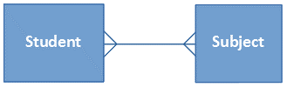

Types of Relations
Many-to-Many
Many teachers teach many students and many students study from many teachers
Many student many subjects and many subjects studied by many students
Many suppliers many products and many products many suppliers
Many records in the first table can be related multiple records in the second table, and multiple records in the second table can be related to multiple records in the first table.
The above relations can be represented as

Slide 9
Entity Relationship Model for a College
Name
Class
Name
University
Roll
Address
Address
Admit
Student
College
Name
Has
Location
College
Departments
HOD
Name
Offers
Subject
Department
Courses
Intake
Study
Student
Courses

Slide 10
Entity Relationship Model for a College
Name
Class
Name
University
Roll
Address
Address
Admit
Student
College
Has
Name
Location
Study
Departments
HOD
Offers
Name
Courses
Subject
Intake

Slide 11
Construct an E-R diagram for a hospital with a set of patients and a set of medical doctors. Associate with each patient a Record of the various tests and examinations conducted.
Treat
Doctor
Patient
Prepares
Doctor
Record
Test
Patient
Record

Slide 12
Assignment
The database for an Airline should store details about an airline’s fleet, flights, and seat bookings. Prepare an ER Diagram, based on following requirements.
An airplane has a model number, a unique registration number, and the capacity to take one or more passengers.
An airplane flight has a flight number, a departure airport, a destination airport, a departure date and time, and an arrival date and time.
Each flight is carried out by a single airplane.
A passenger has given names, a surname, and a unique email address.
A passenger can book a seat on a flight.
Assignment
12

Slide 13
Flies
Airplane
Flight
book
Passenger
Seat
include
Flight
Seat

Slide 14
Assignment
Prepare an ER Diagram for a system in a Hospital with Entities Doctor, Patient, Nurses, Medicines, etc. The diagram should show the Entities, Attributes and Relationships.
Prepare an ER Diagram for a system in a library with Entities like Librarian, Books, Reader and Fine showing the Attributes and Relationships among them.
Assignment
14

Slide 15
Importance of ER Diagram
Database design: ER diagrams are used to model and design relational databases, in terms of logic and business rules.
Database troubleshooting: ER diagrams are used to analyze existing databases to find and resolve problems.
Requirements Gathering : This helps the users to plan how to organize data
Documentation Tool : ER Diagrams can work as a documentation to make others understand the core of the database.
Business process re-engineering (BPR): ER diagrams help in analyzing databases used in business process re-engineering and in modeling a new database setup.
Research: ER diagrams can play a key role to analyze the data.

Slide 16
Disadvantages of E-R Data Model
No industry standard for notation: There is no industry standard notation for developing an E-R diagram.
high-level design: The E-R data model is especially popular for high level and gives a high level overview.

